Slide 1

IBM Applied Data Science Capstone Capstone Project - The Battle of Neighborhoods Opening a Japanese restaurant in New York
By: Wenting Cheng
Jan 2021

Slide 2
Business Problem
.New York City has attracted many people to start businesses in the food industry. Among them, the Japanese restaurant is very popular because of its exquisite health and convenience. This report explores which neighborhoods and districts in New York City have the most and best Japanese restaurant. In addition, I will try to answer the question "Where should I open a Japanese restaurant?" And "If I want great Japanese restaurant, where should I go?"

Slide 3
Data
In order to answer the above questions, data on New York City neighborhoods, boroughs to include boundaries, latitude, longitude, restaurants, and restaurant ratings and tips are required.
New York City data containing the neighborhoods and boroughs, latitudes, and longitudes will be obtained from the data source: https://cocl.us/new_york_dataset
New York City data containing neighborhood boundaries will be obtained from the data source: https://data.cityofnewyork.us/City-Government/Borough-Boundaries/tqmj-j8zm
All data related to locations and quality of Italian restaurants will be obtained via the FourSquare API utilized via the Request library in Python.

Slide 4
Methodology
Data will be collected from https://cocl.us/new_york_dataset and cleaned and processed into a dataframe.
FourSquare be used to locate all venues and then filtered by Japanese restaurants. Ratings, tips, and likes by users will be counted and added to the dataframe.
Data will be sorted based on rankings
Finally, the data be will be visually assessed using graphing from various Python libraries.

Slide 5
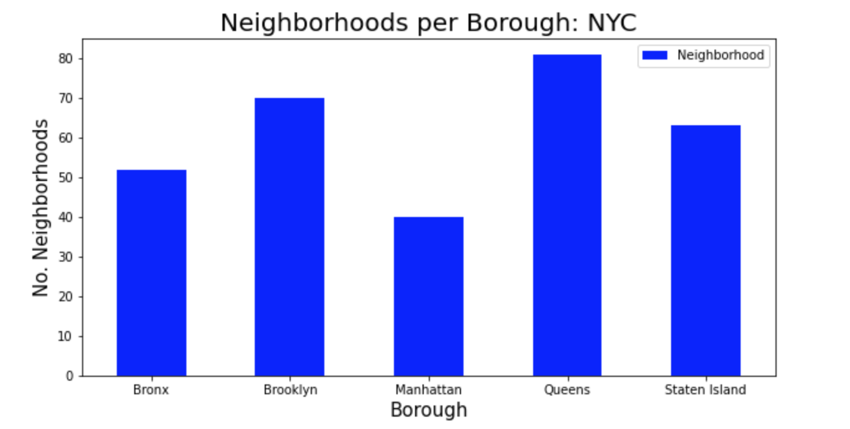
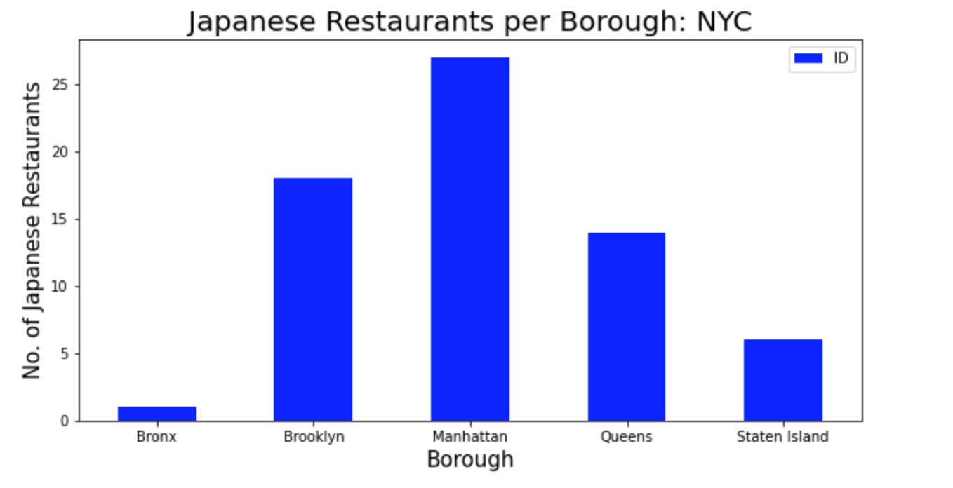
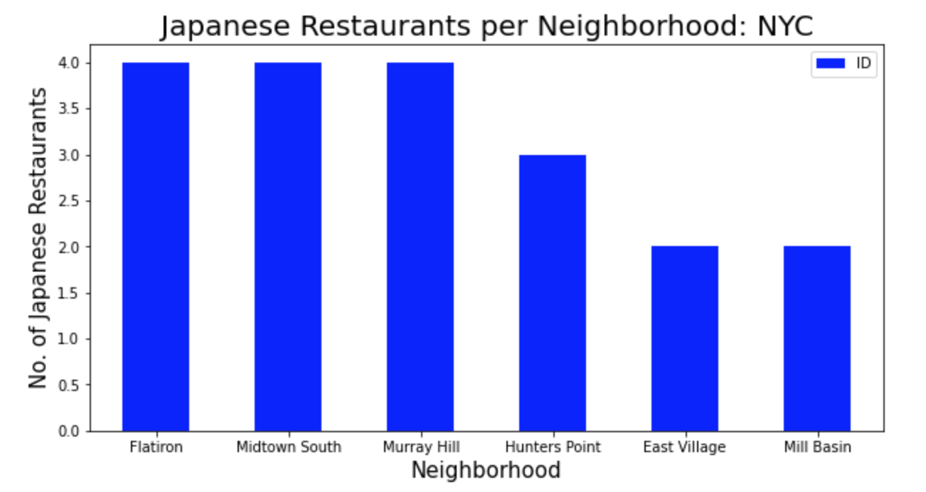
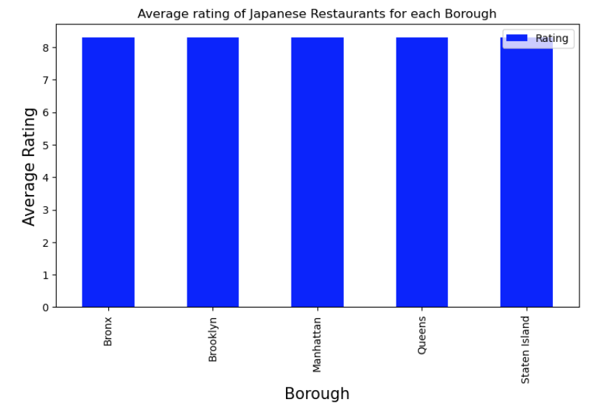
Results
Queens has the highest number of neighborhoods
Manhattan has the highest number of Japanese restaurants.
Flatiron, Midtown South and Murray Hill have the highest number of Japanese restaurants with count 4.
The average rating for Japanese Restaurants are the same for all borough.

Slide 6
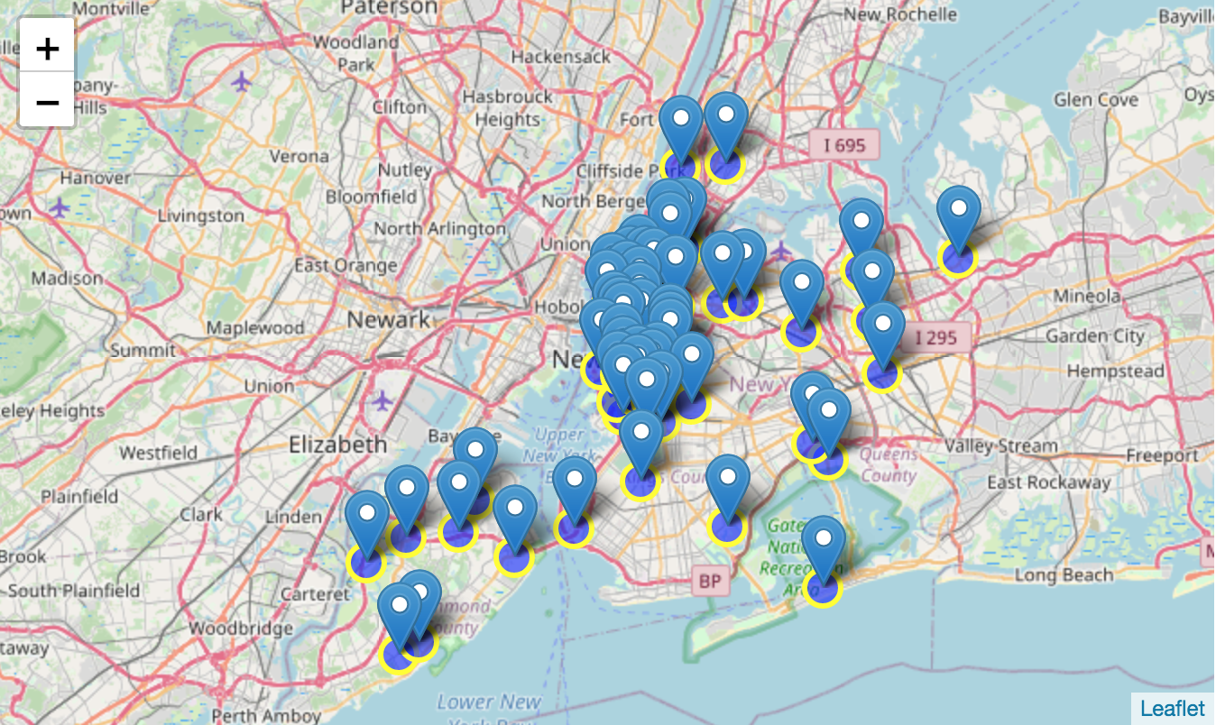
Results
Visualization of the distribution of these Japanese restaurants in NYC.

Slide 7
Discussion
Based on the above information, I would like to point out that Manhattan and Brooklyn are the best places for Japanese cuisine in New York City. For the greatest success, I will recommend open a Japanese restaurant in Brooklyn. Brooklyn has multiple neighborhoods with an average score of 8.3, and there are fewer Japanese restaurants than Manhattan, which makes competition easier. Similarly, we should remember that real estate prices in Brooklyn are much cheaper than in Manhattan.

Slide 8
Conclusion
We have explored the Japanese restaurant data to understand the distribution and rating of various Japanese restaurants in all borough of New York City, this helped us choose the best borough to open a Japanese restaurant.
As a result, for those types of Japanese restaurant which provide quick services and moderate flavor with moderate price, they should consider locations in a busy area and close to other light meals restaurant. For those aiming to provide delicious Japanese cuisine to most picky gourmet, they should open their pizza place at places close to their target customers or customers with a particular background.

Slide 9
Thank you

